Slide 1
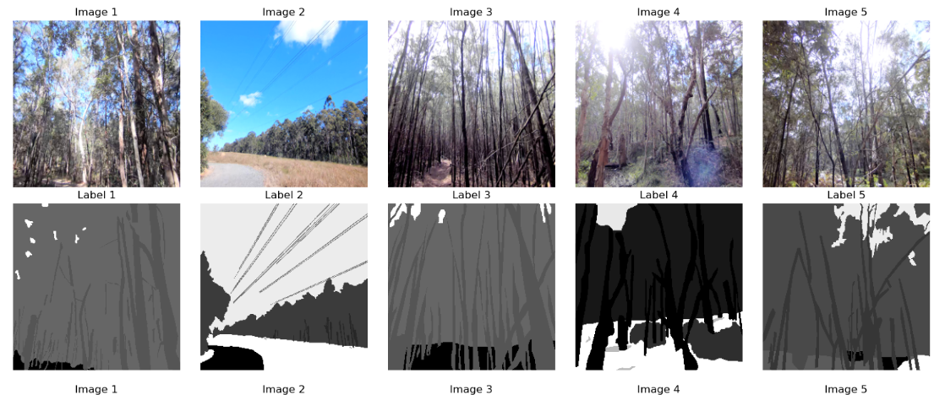
COMP9517: Computer Vision 2024 Term 2 Group Project
9517 puush🌼
Chengpeng Yang (z5455913)
Huayang Xie (z5393197)
Wenjing Wang (z5522320)
Yangfangyuan Zhao (z5543360)
Zelong Hu (z5507000)

Slide 2
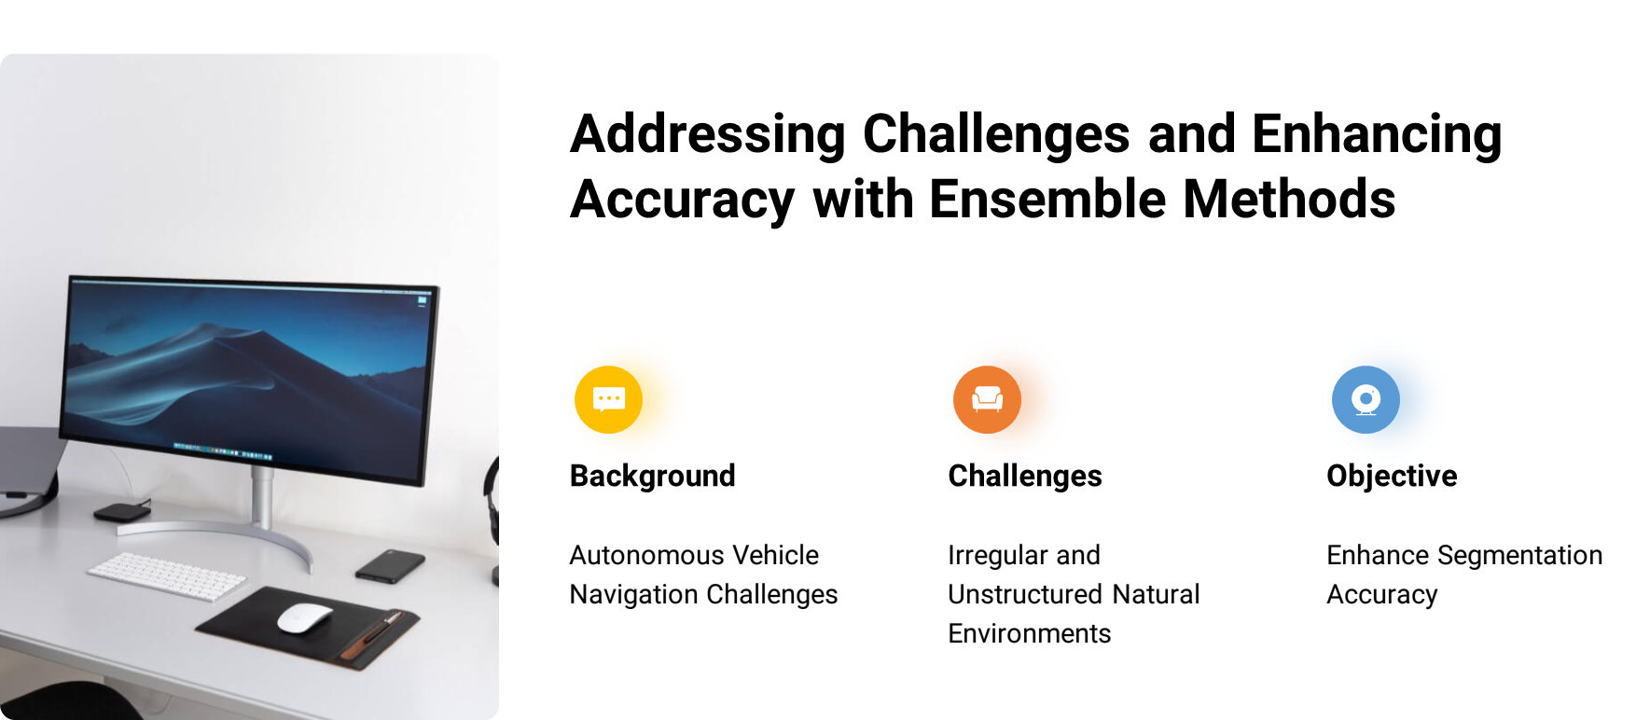
Introduction
Presenter: Zelong Hu (z5507000)

Slide 3
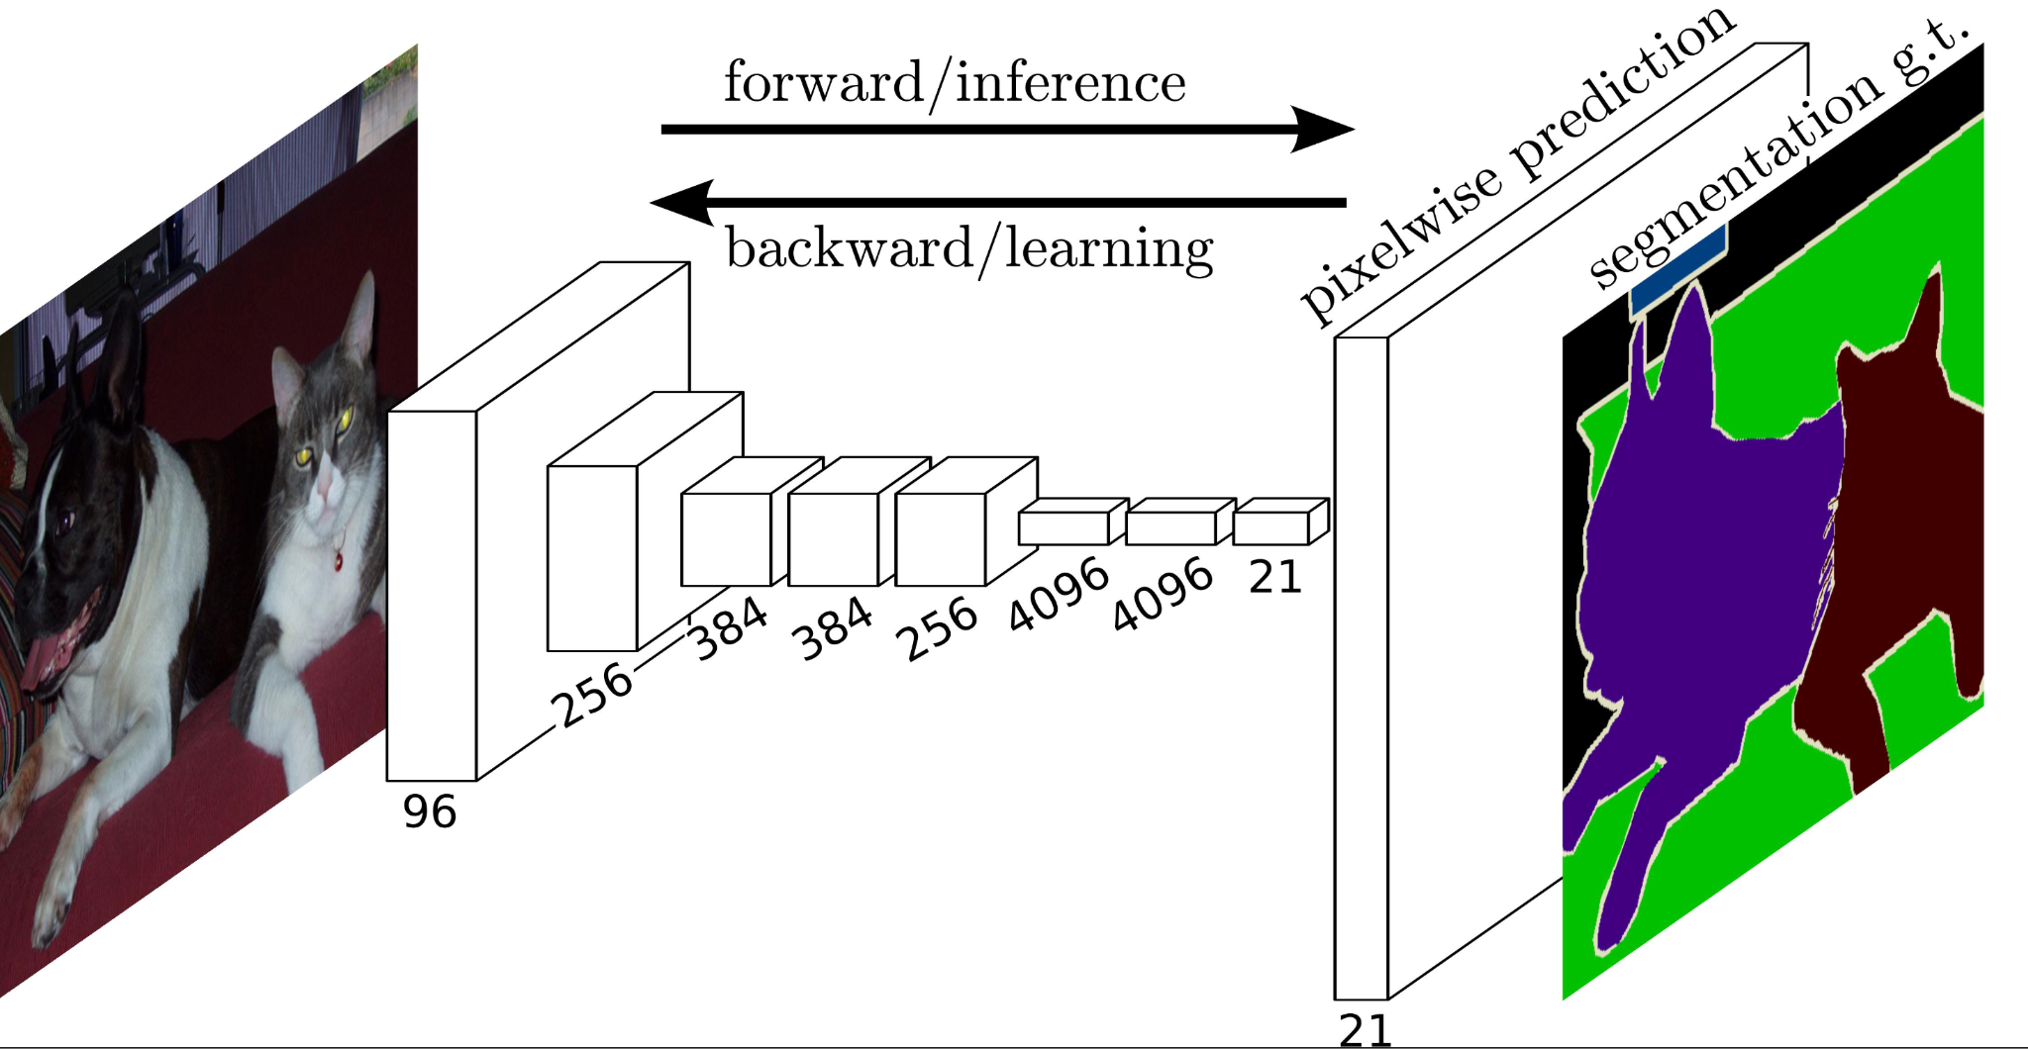
Methods
Fully Convolutional Networks(FCN)
Modification:
MyHead() function explained: it takes in several parameters such as Conv2d, BatchNorm2d, ReLU, dropout and conv2d
Presenter: Wenjing Wang (z5522320)

Slide 4
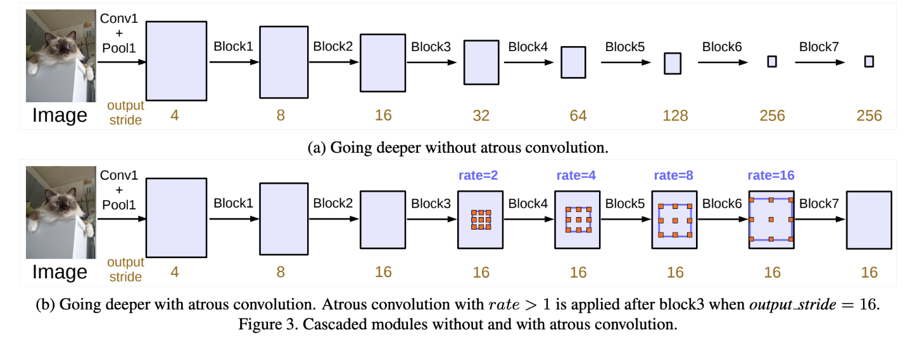
Methods
2. DeepLab v3
Modification: 1. Adjusted to a task-specific setup, introduced a new DeepLabHead() with a 2048 input channels and with the utilisation of the pre-trained ResNet-50
Presenter: Wenjing Wang (z5522320)

Slide 5
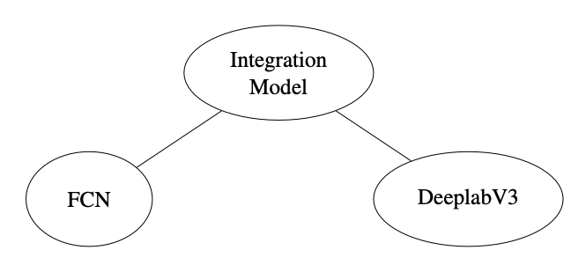
Methods
3. Ensemble(FCN + DeepLab v3 + ResNet-50(Backbone))
Modification:
Fused the outputs of FCN and DeepLabv3 models
Mapped the fused features to the desired number of categories by 1x1 convolutional layer
Advantages:
Improved accuracy
Robustness
Flexibility
Presenter: Wenjing Wang (z5522320)

Slide 6
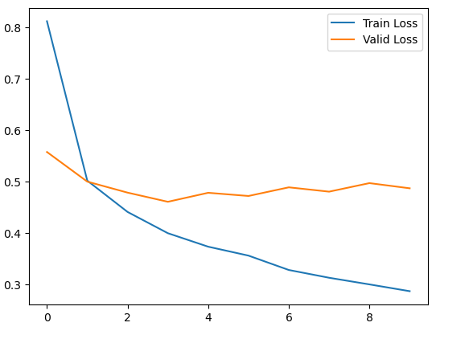
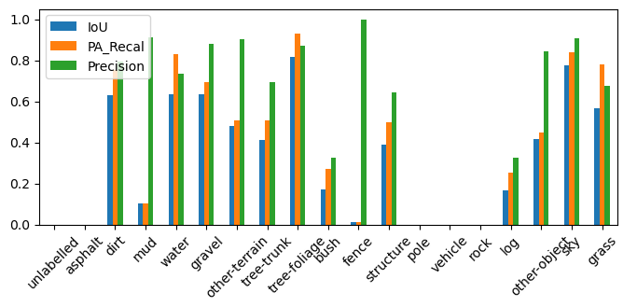
Results
FCN
Validation metric:
mIoU: 32.66
mPA: 39.02
Accuracy: 82.66
Presenter: Yangfangyuan Zhao (z5543360)

Slide 7
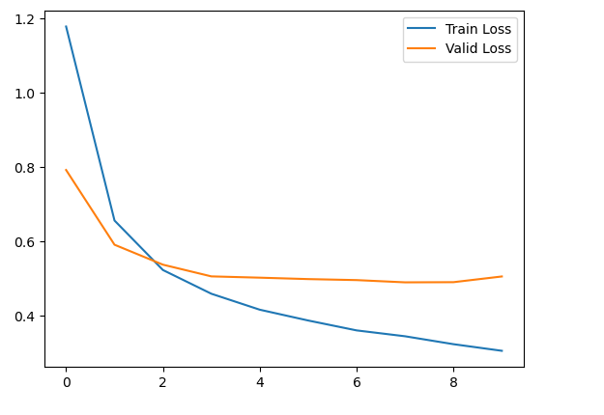
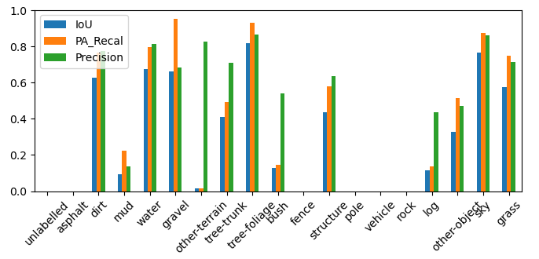
Results
DeepLabv3
Validation metric:
mIoU: 29.74
mPA: 37.82
Accuracy: 82.82
Presenter: Yangfangyuan Zhao (z5543360)

Slide 8
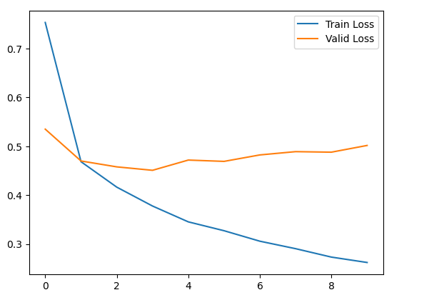
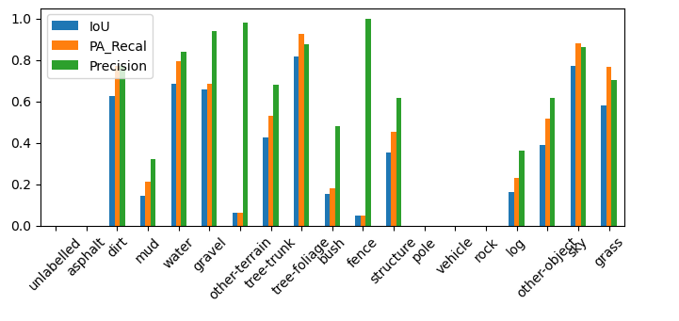
Results
Ensemble
Validation metric:
mIoU: 30.91
mPA: 37.08
Accuracy: 82.80
Presenter: Yangfangyuan Zhao (z5543360)

Slide 9
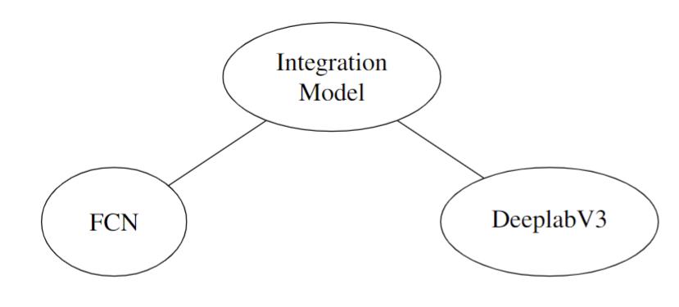
Discussion and conclusion
Presenter: Huayang Xie (z5393197)

Slide 10
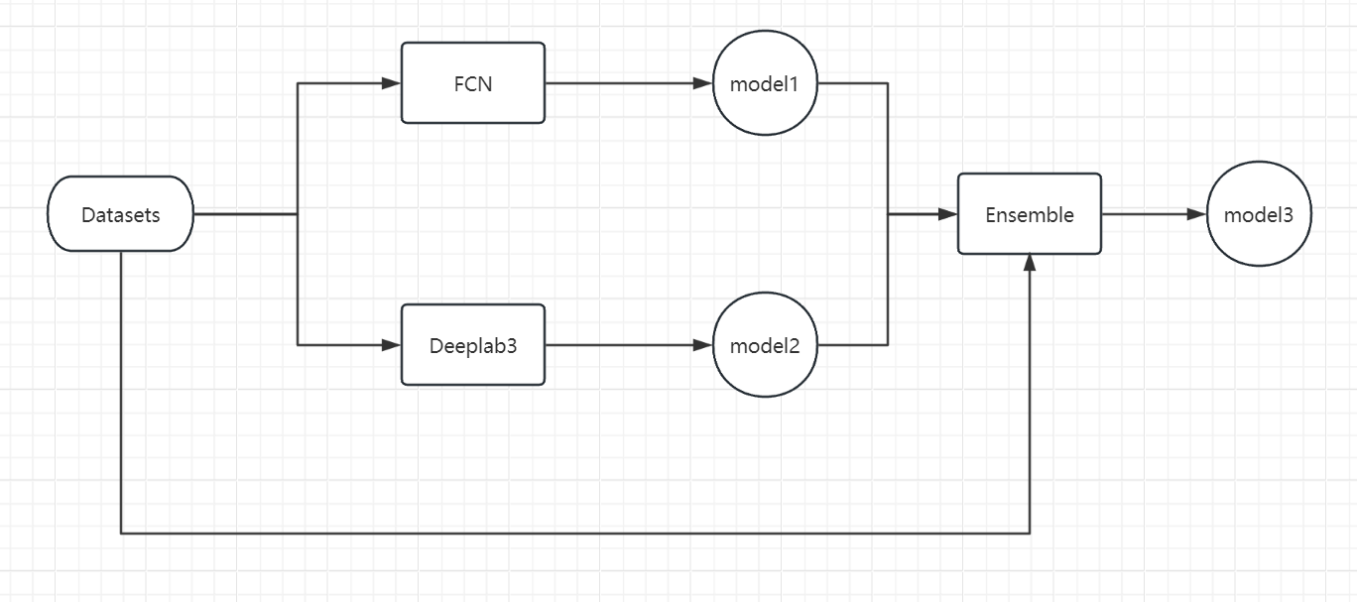
Software Demonstration
FCN
DeepLabv3
Ensemble
Presenter: Chengpeng Yang (z5455913)

